Slide 1
BUSINESS DATA MANAGEMENT
CAPSTONE PROJECT
Optimizing Sales Performance of an E-Commerce Company
Name : Lalit Kumar
Roll No : 21f3003123
Email: 21f3003123@ds.study.iitm.ac.in

Slide 2

Contents
1) Executive Summary | About Organization
2) Data Collection & Cleaning | Data collection and Cleaning Steps
3) Data Analysis | Analysis done in respect to the challenges
4) Result & Findings | Important Insights about business
5) Recommendation | Solutions / Recommendations for business

Slide 3

Executive summary
The organization is an Indian retail business specializing in a diverse range of products across multiple categories. It has a strong online presence and a growing customer base.
Unfortunately the company is facing challenges in terms of sales and profit. Some catgories and sub categories are not performing well.

Slide 4

01
Data Collection & Cleaning
I have collected data from an online repository
Checked data and found some null values and we took necessary steps to remove them
Some columns like date need data type conversion for further analysis
We used Jupyter Notebook and Python to clean, consolidate and perform data analysis.

Slide 5
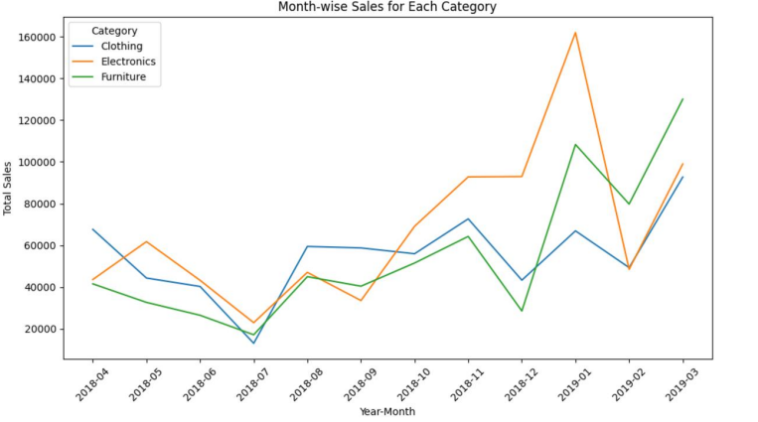
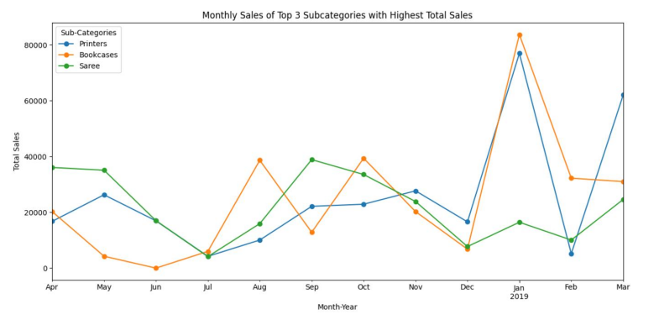

02
Data Analysis
Objective 1: Sales performance analysis

Slide 6
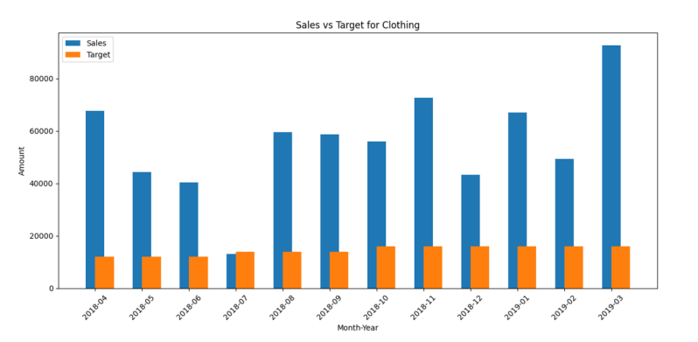
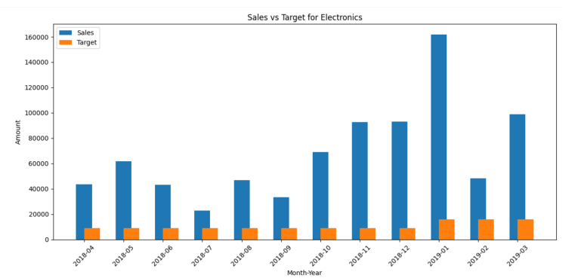
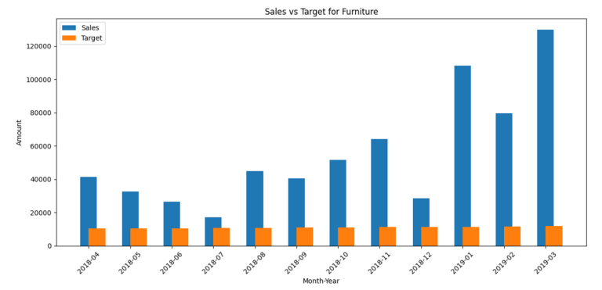
02
Data Analysis
Objective 2: Target Vs Actual Sales

Slide 7
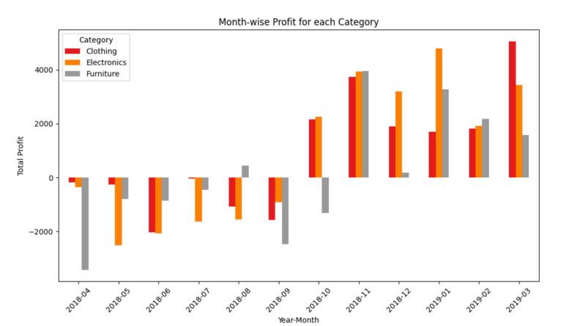
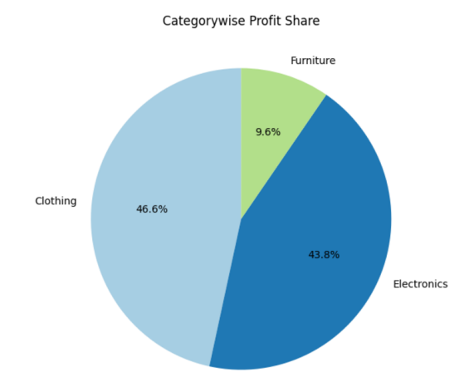
02
Data Analysis
Objective 3: Profit / Loss analysis
Notes:
2-graph) shop is prosperous in Milk & Dairy , Cooking oil sales but their contribution to the overall profit remains significantly lower to that
of others hence lower net profit

Slide 8
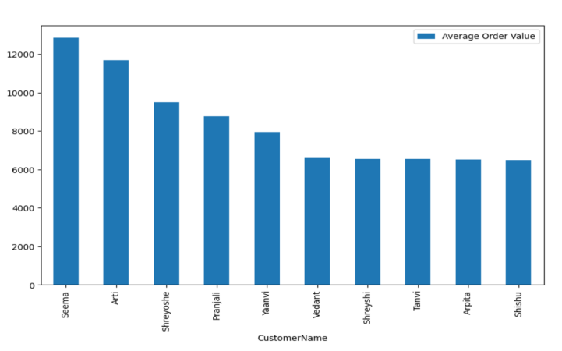
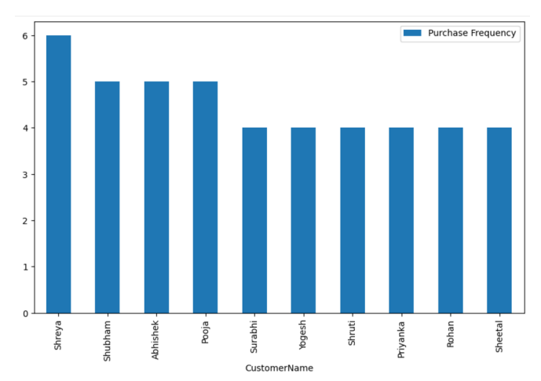
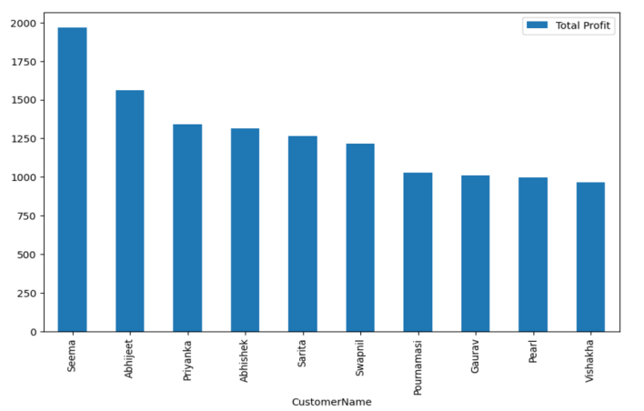
02
Data Analysis
Objective 4 : Customer behaviour analysis

Slide 9
03
Results and Findings
By total sales Furniture is most underperforming category whereas Clothing is highest performing
Leggings, Skirt and Kurtis are most underperforming whereas Printers, Bookcases are top performing subcategories
The company is making highest revenue from Madhya Pradesh whereas lowest from Sikkim and Goa
Similarly in cities company is making highest revenue from Indore whereas lowest from Amritsar
Seema is customer with highest average order value contributing to company's profit whereas Shreya is most frequent buying customer

Slide 10

04
Final Recommendations
Check quality, market demand for furniture and underperforming subcategories and revisit the pricing.
The exception of July for not meeting target in clothing category is possibly due to seasonality, low demands or high market competition
In Madhya Pradesh and Maharashtra company is making highest revenue shows the strong market presence. And low sales in Sikkim and Goa indicate less competitive and untapped market company can expand here.
The high average order value from customer like Seema suggest premium or bulk purchases company can offer exclusive and premium deals to such customers to maintain their engagement. Similarly company can provide personalized offers to customers like Shreya to encourage more spending.

